Slide 1
Adders Project
Supervised by: Eng/ Dina Tantawy

Slide 2
Team members
Name | Section | Bench Number | Email
Yasmine Ashraf Ghanem | 2 | 37 | yasmineashrafghanem@gmail.com
Yasmin Abdullah Nasser | 2 | 38 | yasminelgendi@gmail.com
Mahmoud Seif | 2 | 22 | mahmoud.hussuien99@eng-st.cu.edu.eg
Mohamed Sobhi | 2 | 23 | Sobhiu@gmail.com

Slide 3
workload
Yasmine Ghanem | Plus Adder Carry bypass Adder Carry Look Ahead Adder Testbench ~hrs
Yasmin Elgendi | Carry Ripple Adder Carry Select Adder Carry Save Adder Synthesis ~ hrs
Mahmoud Seif | Carry Increment Adder Carry Skip Adder Carry bypass adder Test bench Synthesis ~hrs
Mohamed Sobhi | Floating Point Adder ~hrs

Slide 4
01
Plus Adder

Slide 5
explanation
Uses the “+” operator in verilog to execute addition.

Slide 6
02
Ripple carry adder

Slide 7
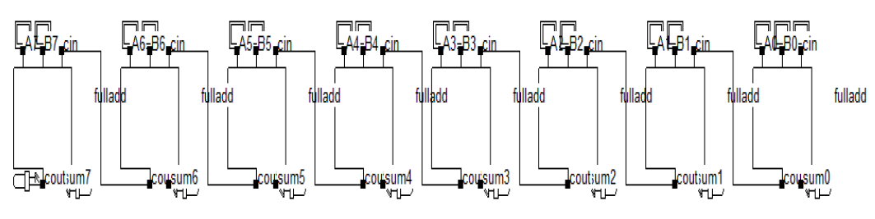
explanation
It’s simply having full adders cascaded after each other. Where each one calculates 2 bits (one from the 1st number and the other from the 2nd number). The Carry out from each one is the Carry in for the one after it.

Slide 8
03
Carry Look ahead adder

Slide 9
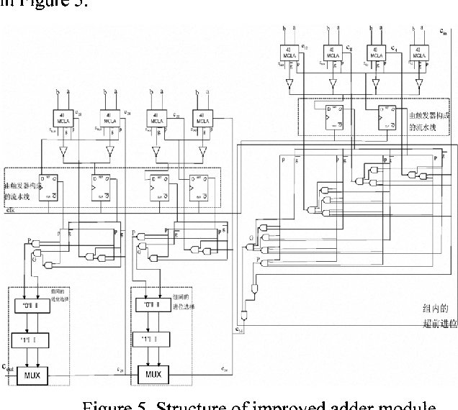
explanation
The carry look ahead adder avoids the latency rippling effect produced by the carry bits by. It generates a specific circuit for calculating the carry bit which reduces the propagation delay of the carry.

Slide 10
04
Carry skip adder

Slide 11
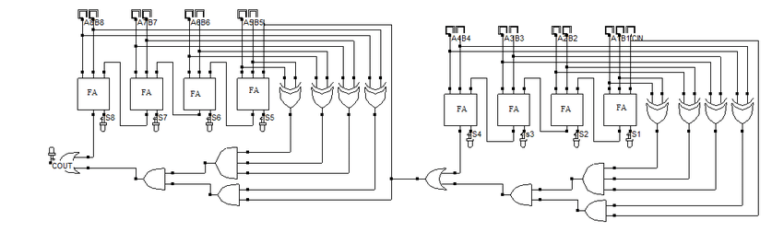
explanation
The 32-bit carry skip adder consist of 8 ripple carry adders each responsible for adding 4 bits. The carry out of each 4 bits is calculated twice; once using the skip logic and once from the ripple carry adder. As the ripple carry adder is faster with smaller number of bits and the propagation delay of the carry; the carry skip adder acts as a multimedia processor for faster addition.

Slide 12
05
Carry select adder

Slide 13
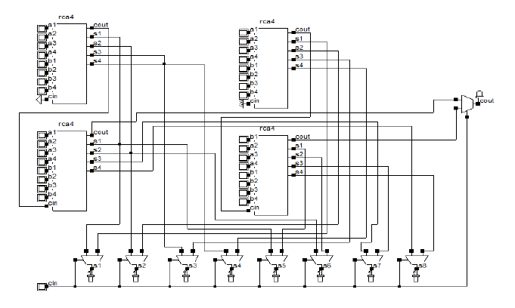
explanation
This adder takes 2 numbers to add and divides them into sections of N-bits (Here we chose to divide them to 4 bits each). Then it adds them with cascaded stages using ripple adders.
It calculates the addition with 2 different scenarios in parallel where the 1st having Cin=0 and the 2nd having Cout=1.
Then the true carry is the selector for the true result.

Slide 14
06
Carry save adder

Slide 15
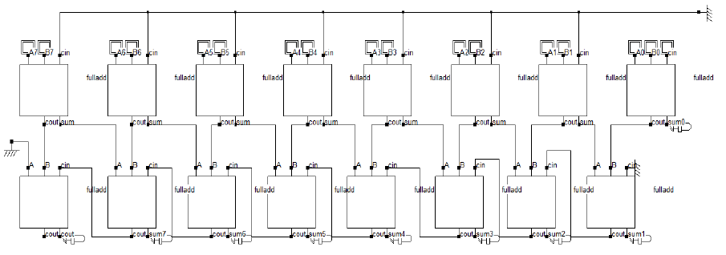
explanation
It divides the addition to 2 numbers only.
Where it has the first sum (partial) of corresponding bits of the number with no cascading for the carry bit (they are all zeros).
First bit is the first bit of the final sum
Then the final sum is calculated by shifting the carry sequence to the left (Ao is the first bot of partial sum) and adding to it the partial sum from the beginning.

Slide 16
07
Carry Increment adder

Slide 17
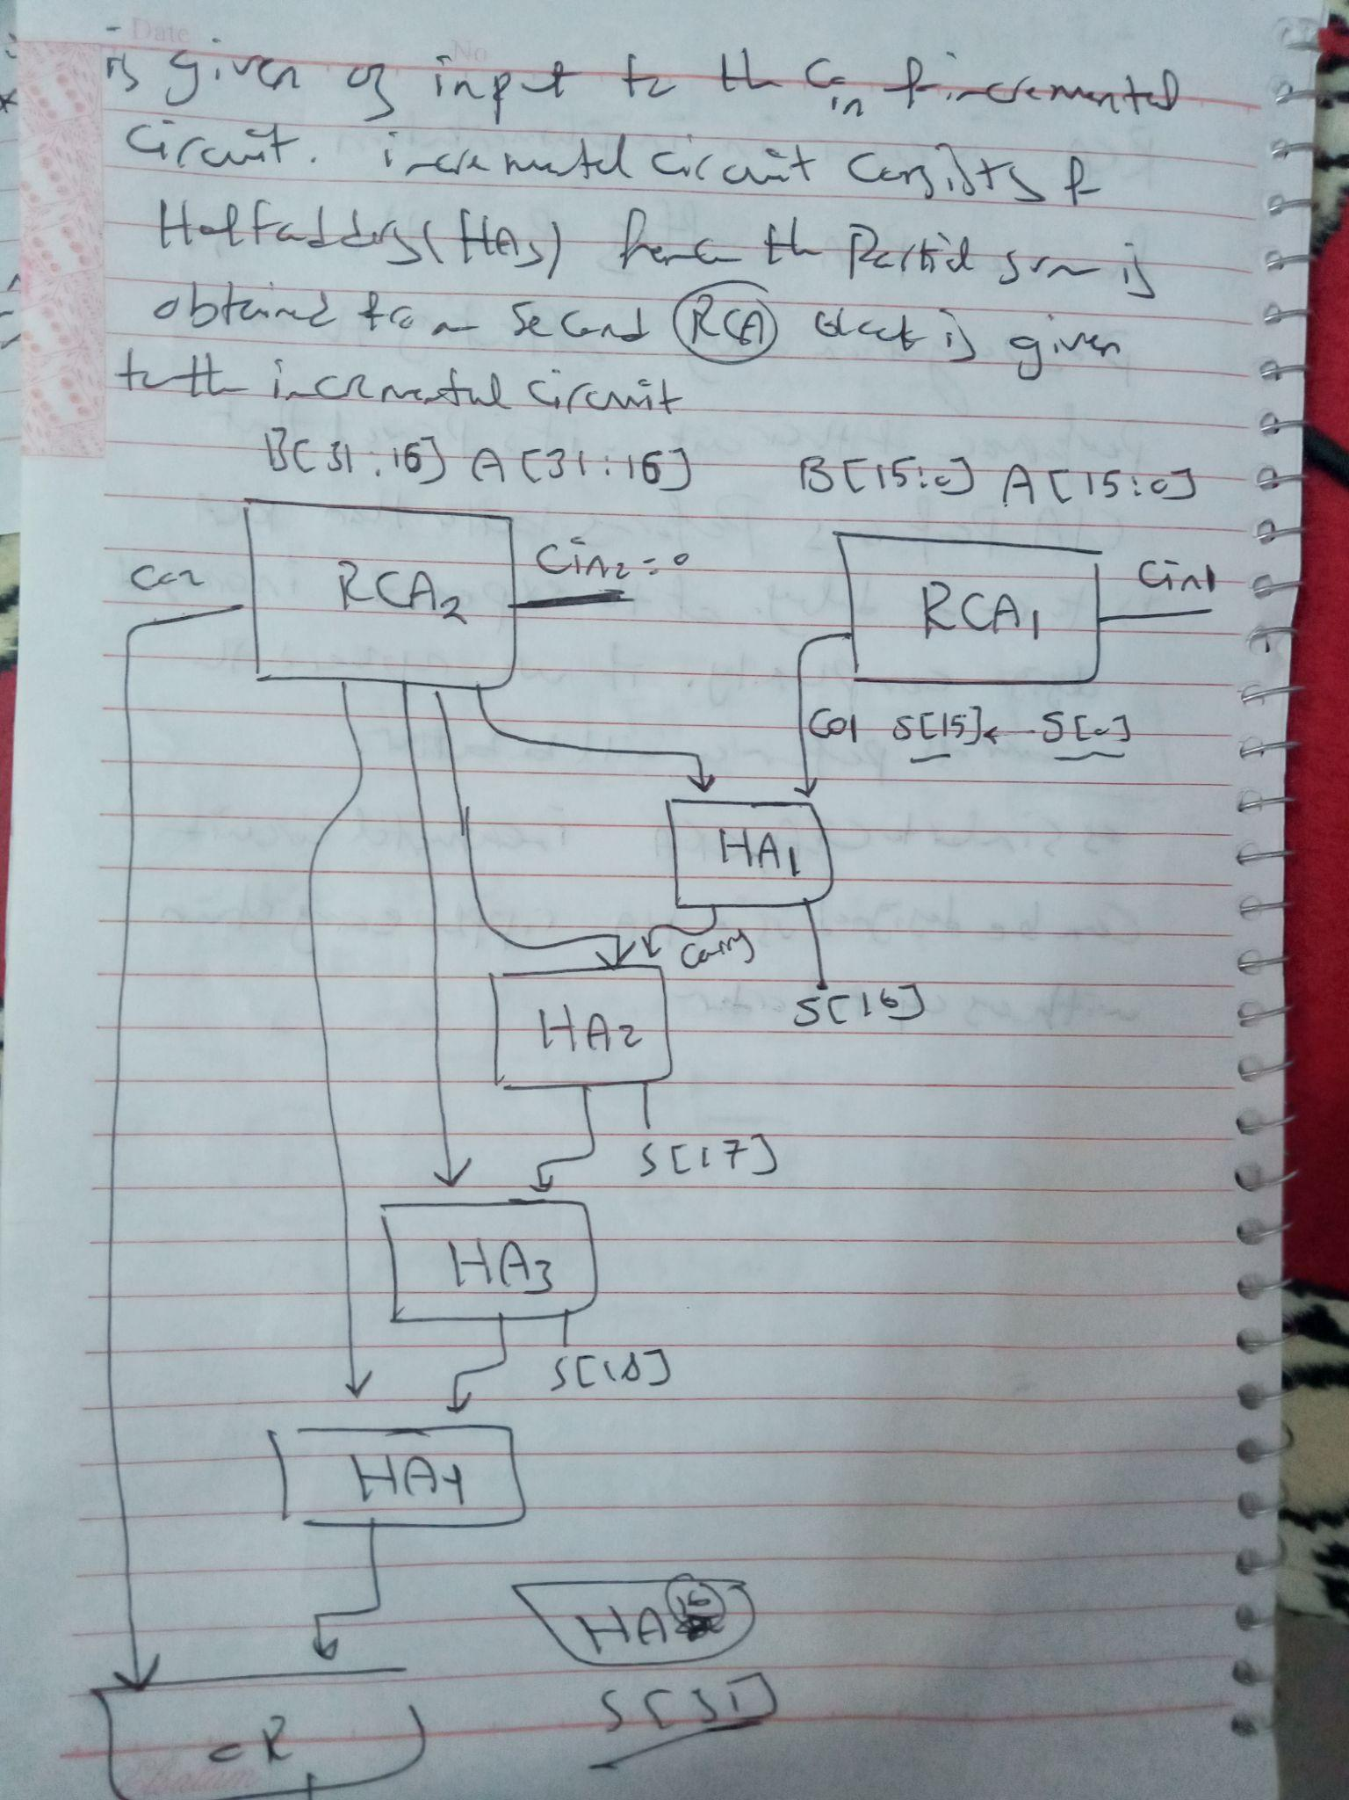
explanation
A 32-bit Carry increment adder uses 2 -16 bit carry ripple adder after splitting the 32 bit operands into 2 16 bit parts then it uses a sequence of half adders to get the second half of the 16-bit sum.

Slide 18
08
Carry bypass adder

Slide 19
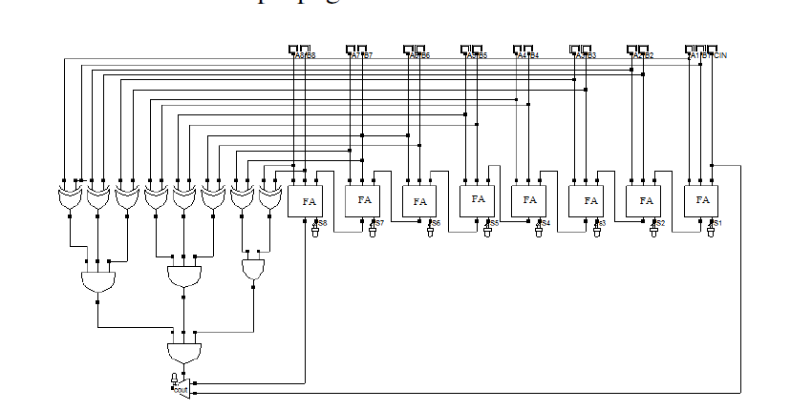
As in a ripple-carry adder, every full adder cell has to wait for the incoming carry before an
outgoing carry can be generated. This dependency can be eliminated by introducing an additional
bypass (skip) to speed up the operation of the adder. An incoming carry Ci,0=1 propagates
through complete adder chain and causes an outgoing carry C0,7=1 under the conditions that all
propagation signals are 1. This information can be used to speed up the operation of the adder, as
shown in Figure (8). When BP = P0P1P3P4P5P6P7P8 = 1, the incoming carry is forwarded
immediately to the next block through the bypass and if it is not the case, the carry is obtained via
the normal route. If (P0P1P3P4P5P6P7 = 1) then C0,7 = Ci,0 else either Delete or Generate
occurred. Hence, in a CBA the full adders are divided into groups, each of them is “bypassed” by
a multiplexer if its full adders are all in propagate
explanation

Slide 20
09
Floating point adder

Slide 21
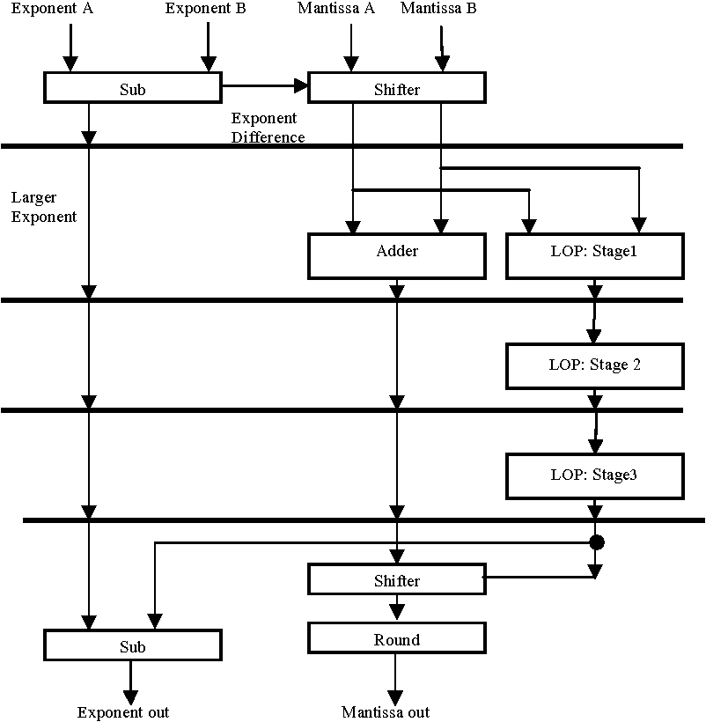
explanation
the 32 bit floating point adder contains two entities and the multiplexer that used to setting the correct result in the output , the multiplexer has three inputs N1,N2 and enable.
the output is Result which contains the 32 bits (Sign, exponent and
mantissa) result.
works by 4 main stages in stage 1 it's compare the two entities by subtracting each other and then move to compare the fractions then stage 2 shift right the fraction with the smaller exponent .
then move to the stage 3 normalization step by shift the result and increment or decrement according to this result .
if the exponent overflow we will need to round the result , if it's not then no need to round operation .

Slide 22
Justification
Verilog (‘+’) version of adders
Smallest cell area
Minimum power consumption
Minimum output delay

Slide 23
challenges
Timing report
FPA
Timing report only showed slack time for one path and neglected the other 2 paths.
Report_timing command of the FPA was not executing correctly (didn’t show results).

Slide 24
Thank you

